Slide 1
Oscillators

Slide 2
What is oscillator?
Oscillation is the repetitive variation of some quantity with reference to a central value.
An electronic circuit that produces a repetitive, oscillating electronic signal.
Oscillators are often characterized by the frequency of their output signal:
• Audio oscillator
• Radio Frequency oscillator
• Low Frequency Oscillator
Oscillators designed to produce a high-power AC output from a DC supply are usually called inverters.
Common signals generated by the oscillators includes clock signals, sound signals produced by video games, electronic beepers and broadcast signals by television and radio transmitters

Slide 3
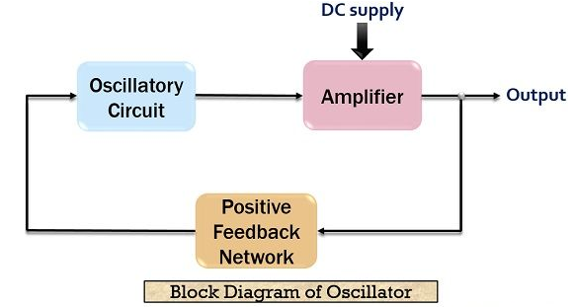
Block Diagram

Slide 4
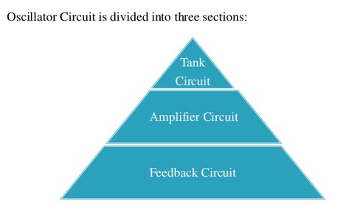
Basic Oscillator circuit consists of:

Slide 5
Sections of Oscillator
Tank Circuit produces oscillations which are amplified by the transistor and produces amplified output in the collector side.
Amplifier circuit basically amplifying the small sinusoidal oscillations present in the base-emitter circuit and generates output in the amplified form.
Feedback circuit fed back the energy of the collector circuit to the base circuit.

Slide 6
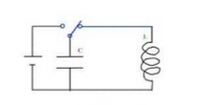
Basic LC oscillator
In LC oscillators, the inductor and capacitor are connected in parallel form a Tank circuit.
Tuned circuit can store electrical energy oscillating at its resonant frequency.
Used in radio frequency circuits because of their ease of implementation and good phase noise characteristics.

Slide 7
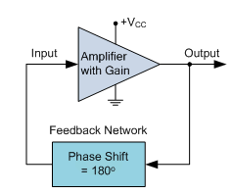
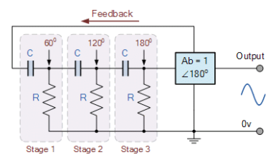
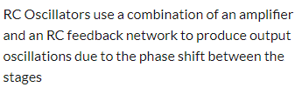
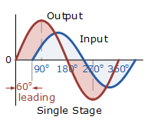
RC coupled oscillator

Slide 8
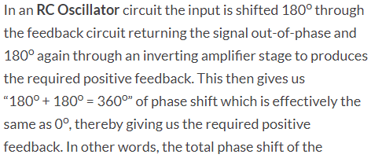
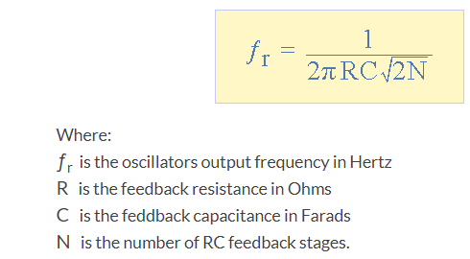

Slide 9
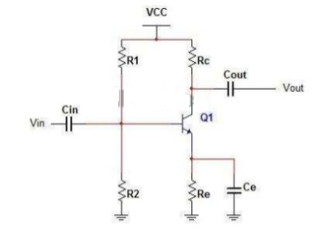
Single Stage common emitter Amplifier

Slide 10
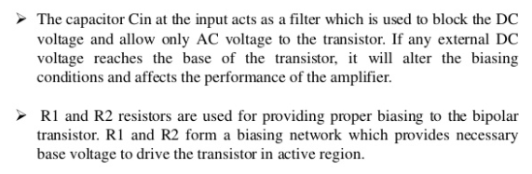
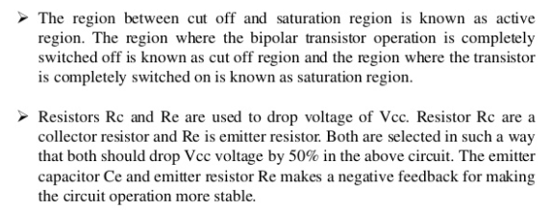
Working of Amplifier

Slide 11
Thank You

